Slide 1
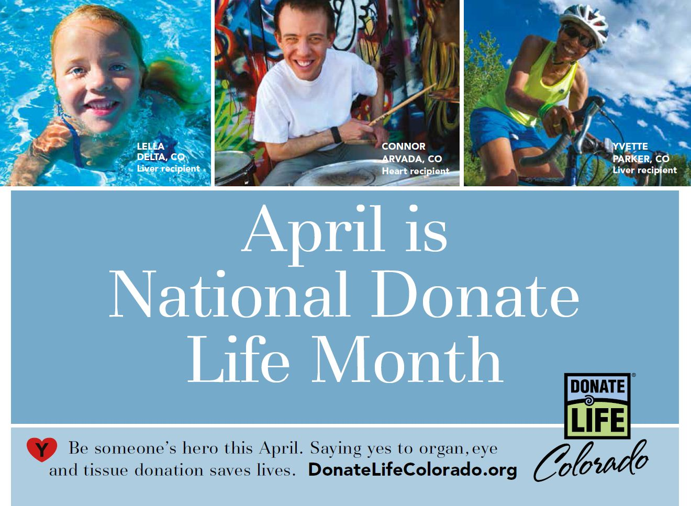

Slide 2
ANYONE CAN REGISTER:
Anyone, regardless of age, lifestyle or medical condition can register as a donor.
Patients with diabetes, hepatitis and other chronic conditions can potentially save and heal lives.

Slide 3
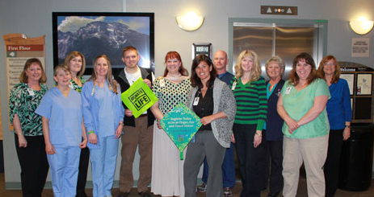
National Blue & Green Day is April 17
Celebrate the lifesaving gift of donation by wearing your brightest blue & green!

Slide 4
MEDICAL CARE:
Your decision to be an organ, eye and tissue donor will not interfere
with your medical care. Doctors and nurses caring for you before death
are not involved in the donation process.

Slide 5
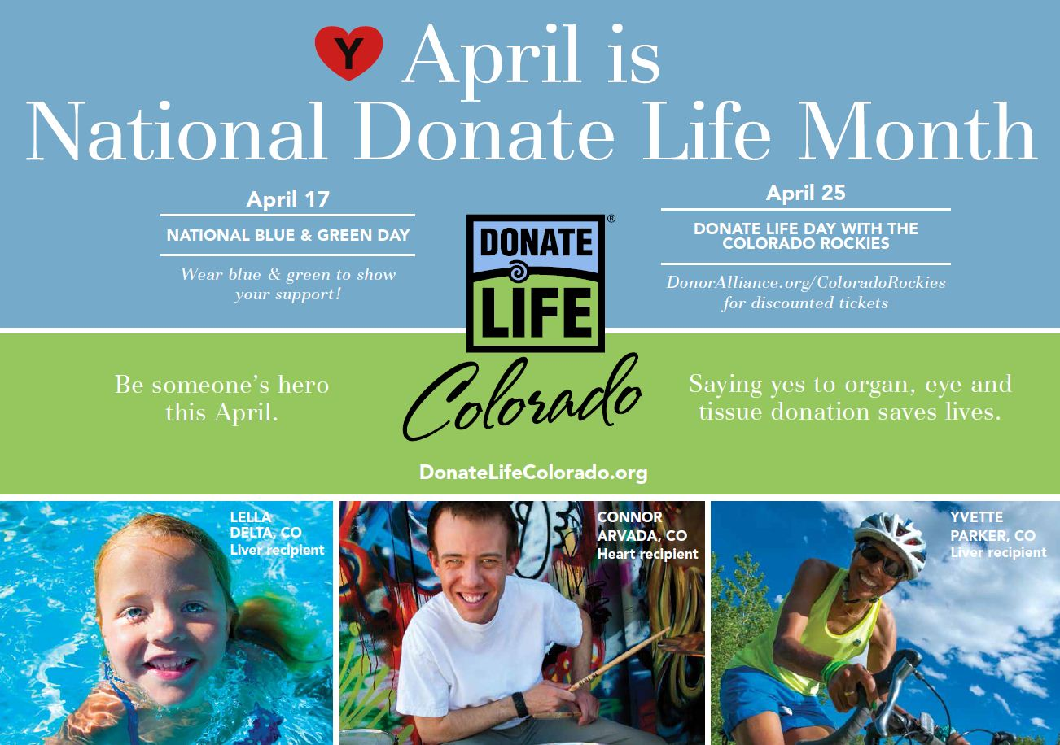

Slide 6
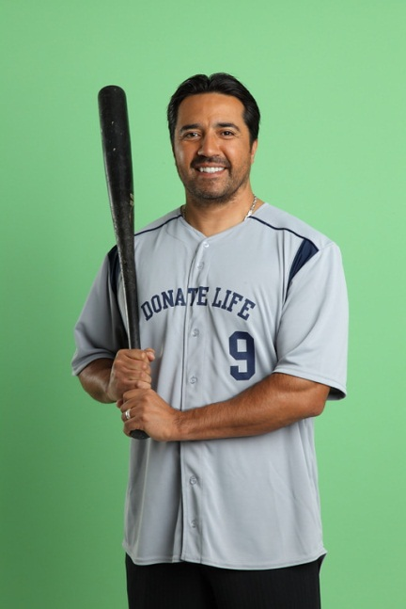
Donate Life Day with the Colorado Rockies is April 25
Celebrate National Donate Life Month with discounted tickets to the Colorado Rockies vs. San Francisco Giants!
Free coozies for the first 15,000 fans
Photos and autographs with Donate Life Advocate and baseball legend Vinny Castilla
Interactive fan kiosk and photo booth
Don’t miss the pre-game ceremony featuring local transplant recipients
Visit DonorAlliance.org/ColoradoRockies for more info.

Slide 7
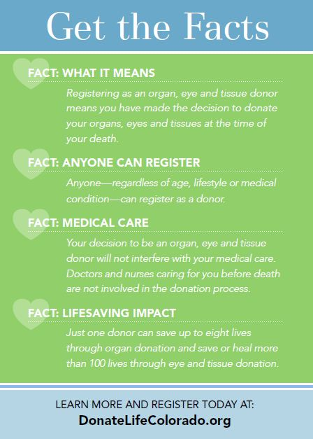

Slide 8
A single donor can save more than 100 Lives!
An organ donor can save 8 lives through organ donation.
A tissue donor can save or heal more than 100 lives through tissue donation.

