Slide 2
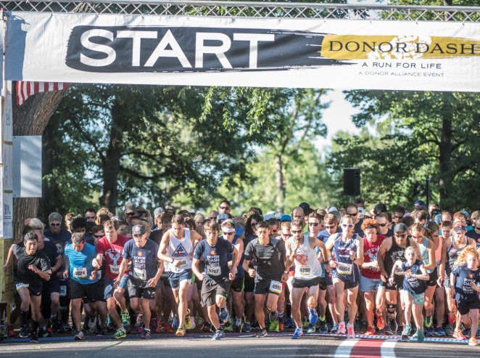
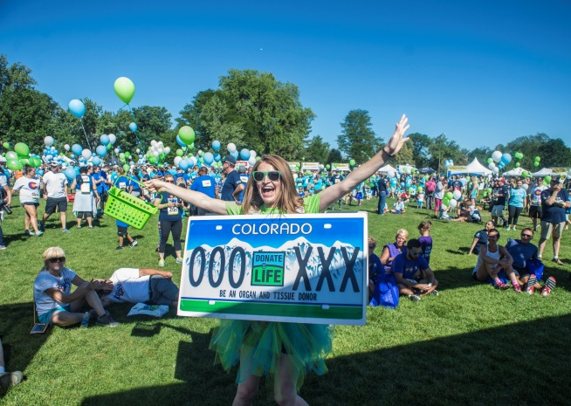
The Donor Dash 5K is for runners, walkers and the entire family to HONOR the lives of organ and tissue donors, CELEBRATE the lives of organ and tissue recipients and RECOGNIZE those waiting for a lifesaving transplant.
REGISTER TODAY!
www.DonorAlliance.org/DonorDash

Slide 3
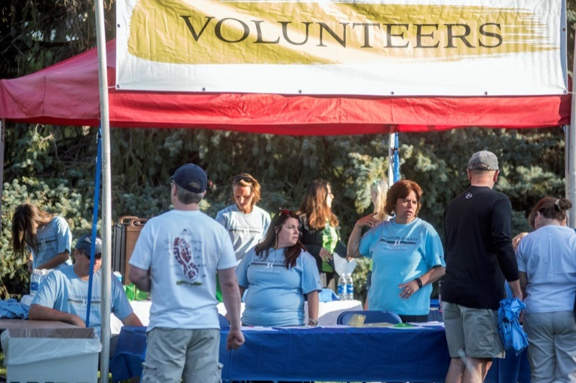
Can’t run or walk in the Donor Dash but still want to take part in all of the fun? Sign up to volunteer! We need course marshals, registration, start/finish line and course water station volunteers just to name a few! Each volunteer receives a free race registration for themselves or a friend!
www.DonorAlliance.org/programs/donor-dash/volunteer/

Slide 4
Join Our Team!
(Insert team name or business name here) will be out in force at the 2019 Donor Dash and we want you to join in on the fun! Register today at www.DonorAlliance.org/DonorDash and look for our team name! We’ll see you on July 21st!

