Slide 2
ANYONE CAN REGISTER:
Anyone, regardless of age or medical condition can register as a donor.
Patients with diabetes, hepatitis and other chronic conditions can potentially save and heal lives.

Slide 3
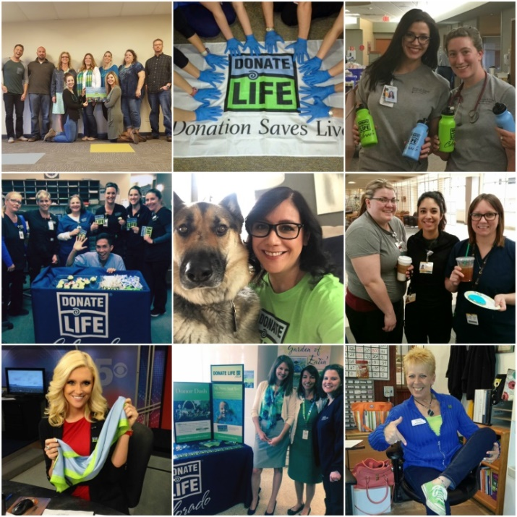
National Blue & Green Day is April 13th
Celebrate the lifesaving gift of donation by wearing your brightest BLUE & GREEN!

Slide 4
MEDICAL CARE:
Your decision to be an organ, eye and tissue donor will not interfere
with your medical care. Doctors and nurses caring for you before death
are not involved in the donation process.

Slide 5
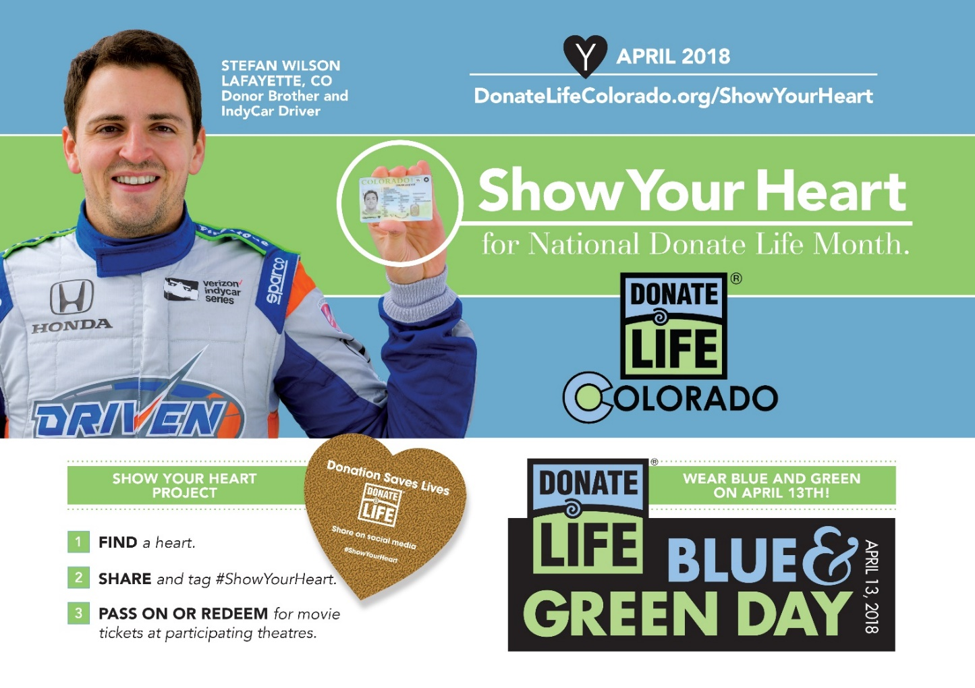

Slide 6
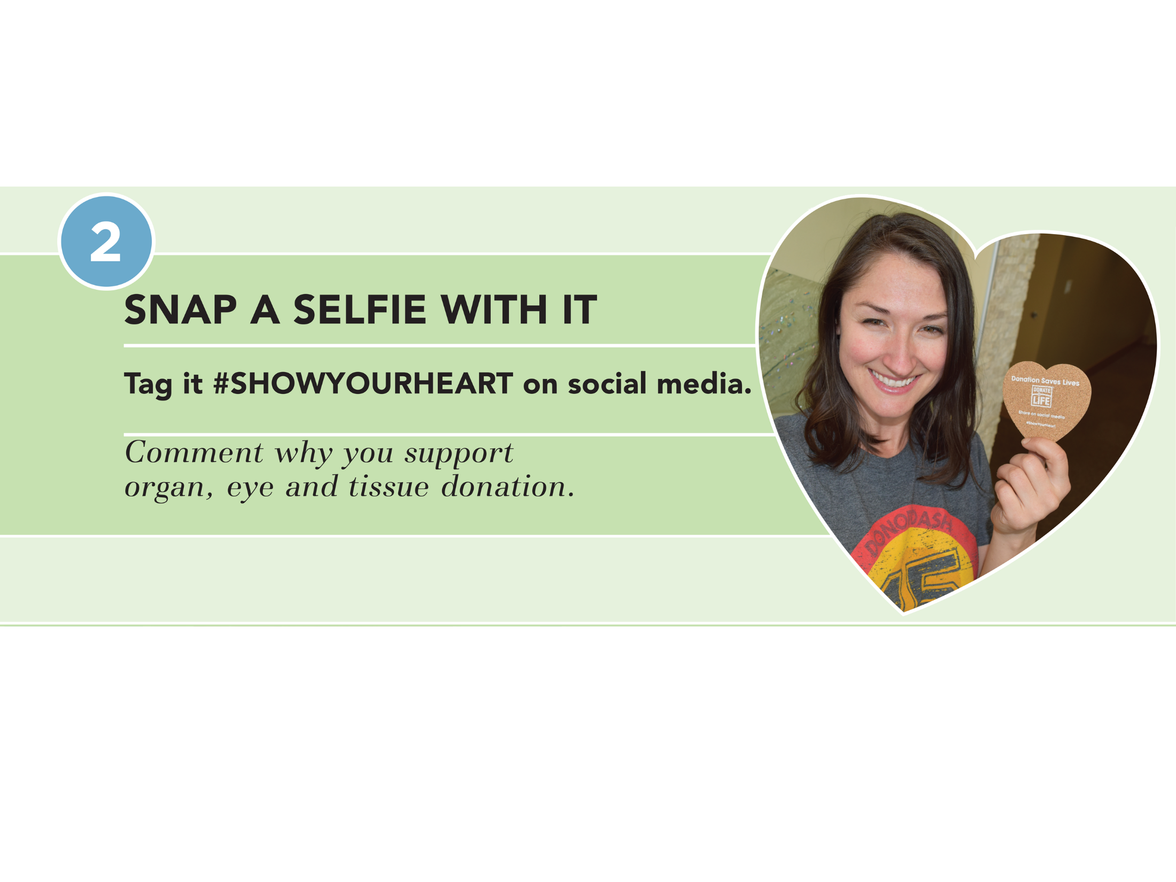
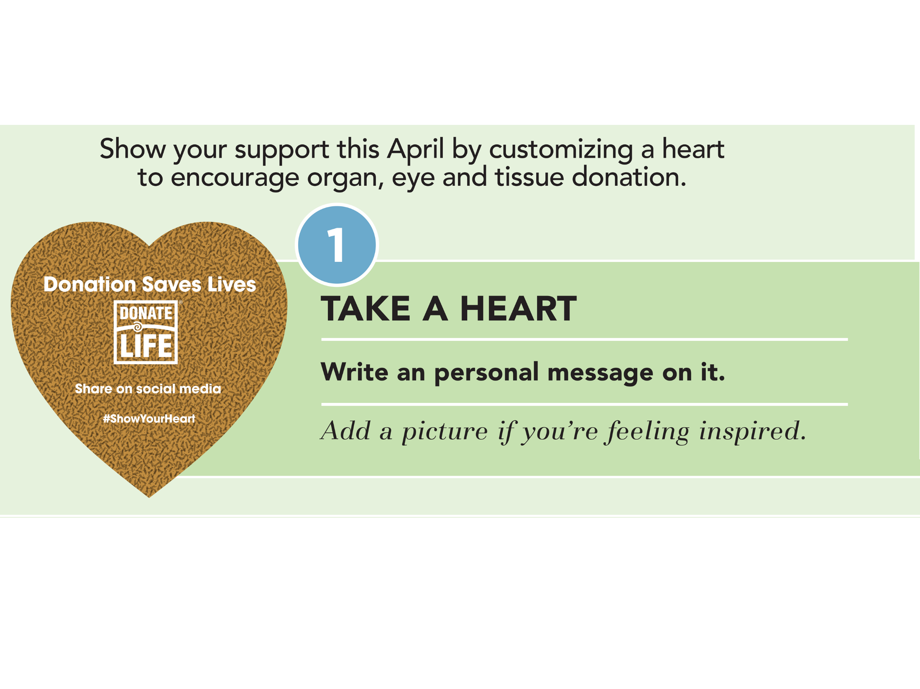

Slide 7
A single donor can save more than 75 Lives!
An organ donor can save 8 lives through organ donation.
A tissue donor can save or heal more than 75 lives through tissue donation.

